Slide 1


Simón Zarama Pombo
15/12/2024

Slide 2

Outline
Executive Summary
Introduction
Methodology
Results
Conclusion
Appendix

Slide 3
Executive Summary
For this project, we began by gathering as much relevant data as possible and then enhanced its quality through data wrangling. We utilized SQL to extract insights, along with data analysis libraries such as Matplotlib, Seaborn, Pandas, and NumPy for statistical analysis and data visualization. Our exploration of SpaceX operations deepened with Folium, where we examined the launch sites and discovered that they were not used equally; two out of the four sites emerged as the primary locations.
We created an interactive dashboard for stakeholders to explore metrics that interest them, providing a more comprehensive view of SpaceX's situation. Ultimately, we employed machine learning to predict whether the first stage of the Falcon 9 would land successfully. We identified the optimal hyperparameters for models such as Support Vector Machine (SVM), Classification Trees, Logistic Regression, and K-Nearest Neighbors (KNN). However, while our models were capable of making accurate predictions, we found that the dataset was too small to yield significant new insights.

Slide 4
Introduction
For this project, we are envisioning a scenario where we have been contracted by a billionaire named Allon Mask, who aims to establish a company called SpaceY. Our objective is to analyze the current state and operations of SpaceX, as well as to explore the latest advancements in reusable rocket technology. We intend to develop a predictive model that will assess the likelihood of a rocket being reused.
If a rocket landing is successful, it can be reused at a cost of approximately $65 million. Conversely, if it fails, the cost of a new rocket rises to around $165 million, resulting in an estimated difference of $100 million.

Slide 5

Section 1

Slide 6
Methodology
Executive Summary
Data collection methodology:
Describe how data was collected
Perform data wrangling
Describe how data was processed
Perform exploratory data analysis (EDA) using visualization and SQL
Perform interactive visual analytics using Folium and Plotly Dash
Perform predictive analysis using classification models
How to build, tune, evaluate classification models

Slide 7
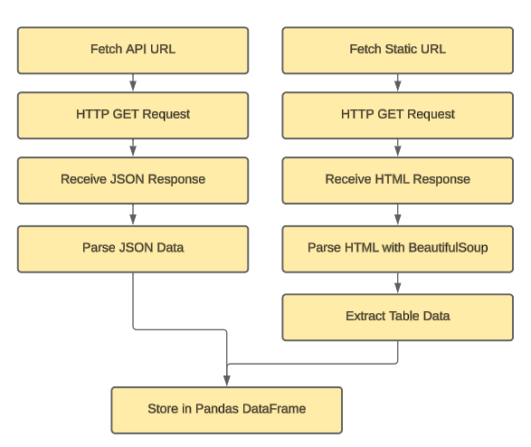
Data Collection
Data was gathered from the Wikipedia page titled "List of Falcon 9 and Falcon Heavy launches" and SpaceX’s API. We utilized Python libraries and BeautifulSoup for parsing that content and data manipulation. Ultimately, we transformed the HTML data and the Json response into a Pandas DataFrame for further analysis.

Slide 8
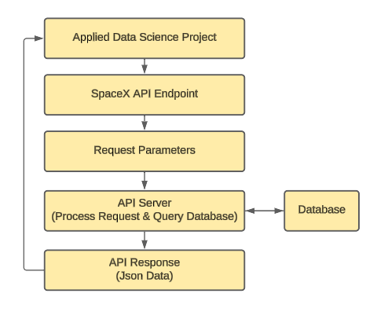
Data Collection – SpaceX API
We worked with the SpaceX API to collect data by making HTTP GET requests to various API endpoints (rockets, launchpads, payloads, etc). The JSON responses were parsed and processed using Python libraries like requests for HTTP requests and pandas for data manipulation. The extracted data was then stored in structured formats, such as DataFrames, for further analysis.
GitHub:
https://github.com/simonzarama/coursera/blob/main/jupyter-labs-spacex-data-collection-api.ipynb

Slide 9
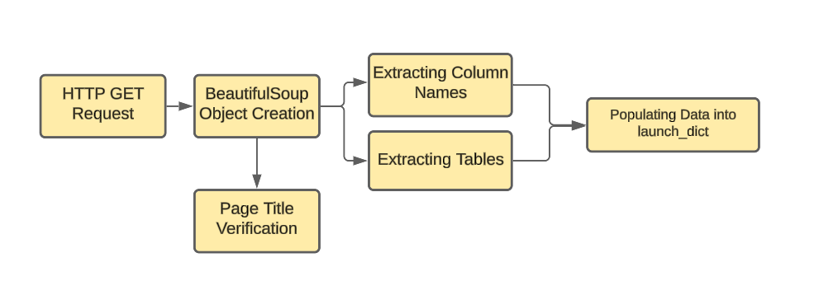
Data Collection - Scraping
This flowchart outlines the data extraction process we used, starting from acquiring the HTML content of the Wikipedia page and continuing through to managing any missing or inconsistent data.
GitHub:
https://github.com/simonzarama/coursera/blob/main/jupyter-labs-webscraping.ipynb

Slide 10
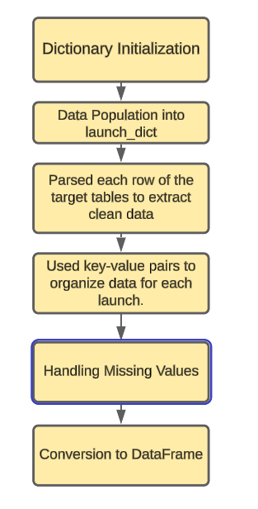
Data Wrangling
The data wrangling process involved initializing a dictionary (launch_dict) with column names as keys and empty lists as values, then populating it with cleaned data extracted from table rows. Finally, the structured data was converted into a pandas DataFrame for analysis.
GitHub:
https://github.com/simonzarama/coursera/blob/main/jupyter-labs-webscraping.ipynb

Slide 11
EDA with Data Visualization
In this section, we plotted and compared various variables to identify patterns in SpaceX launches. Our primary focus was on the success rate over time, examining its relationship with factors such as target orbit, launch site, and payload mass. Additionally, we analyzed how these variables interconnect; for instance, the correlation between target orbit and payload mass.
GitHub link:
https://github.com/simonzarama/coursera/blob/main/edadataviz.ipynb

Slide 12
EDA with SQL
Using SQL queries, we:
Formed a clearer picture of mission outcomes, distinguishing between successes and failures based on different factors like landing sites (drone ship vs. ground pad).
Analyzed payload mass data to understand how payload capacities varied with different booster versions and their impact on mission outcomes.
Examined changes over time by focusing on specific date ranges, tracking first successes in ground landings and the overall trend in mission outcomes.
Gained insights into SpaceX's operational evolution, challenges, and improvements in achieving mission success.
GitHub link:
https://github.com/simonzarama/coursera/blob/main/jupyter-labs-eda-sql-coursera_sqllite.ipynb

Slide 13
Build an Interactive Map with Folium
In this section, we used different Folium tools to gain a better understanding of SpaceX launching sites. Some of these tools included:
a) Circles: to visualize areas of interest.
b) Markers: Highlight specific locations.
c) MarkerCluster: to group many data points on the map.
c) MousePosition: to display real-time coordinates on the map.
d) PolyLine: to connect two points on the map and know the distance between them.
e) Popup: to name our selected coordinates
GitHub link:
https://github.com/simonzarama/coursera/blob/main/lab_jupyter_launch_site_location.ipynb

Slide 14
Build a Dashboard with Plotly Dash
On our dashboard, we created two interactive graphs that enable us to modify the criteria for closely examining the results.
The first graph is a pie chart that illustrates the distribution of successful launches across all launch sites. This allows us to analyze each site individually and understand the proportion of successful launches at each location.
The second graph provides insights into the types of boosters used and the weights of the payloads. This table allows us to view results for all launch sites collectively or focus on individual sites.
Together, these two types of graphs give us a comprehensive overview of SpaceX launches, helping us identify patterns and gain a better understanding of SpaceX's operational strategies and the current state of its technology.
GitHub link:
https://github.com/simonzarama/coursera/blob/main/spacex_dash_app.py

Slide 15
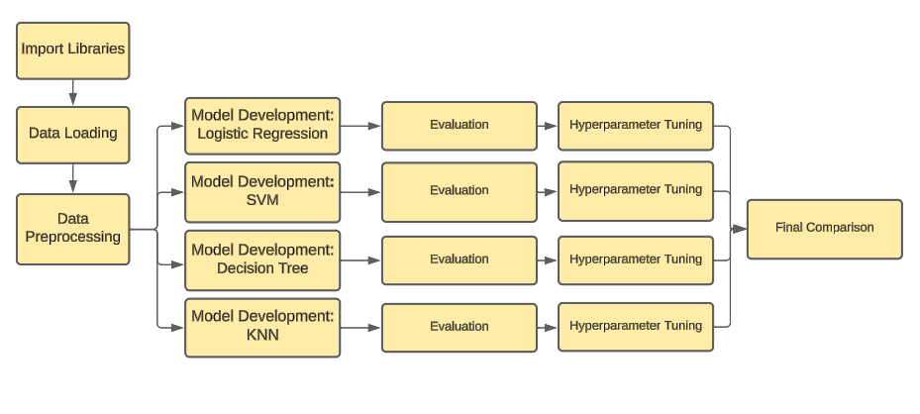
Predictive Analysis (Classification)
This flowchart illustrates the process we followed in this section, including building and evaluating four different classification models using metrics such as the F1-score and confusion matrices.
GitHub link:
https://github.com/simonzarama/coursera/blob/main/SpaceX_Machine%20Learning%20Prediction_Part_5.ipynb

Slide 16
Results
Exploratory data analysis results
Interactive analytics demo in screenshots
Predictive analysis results

Slide 17

Section 2

Slide 18
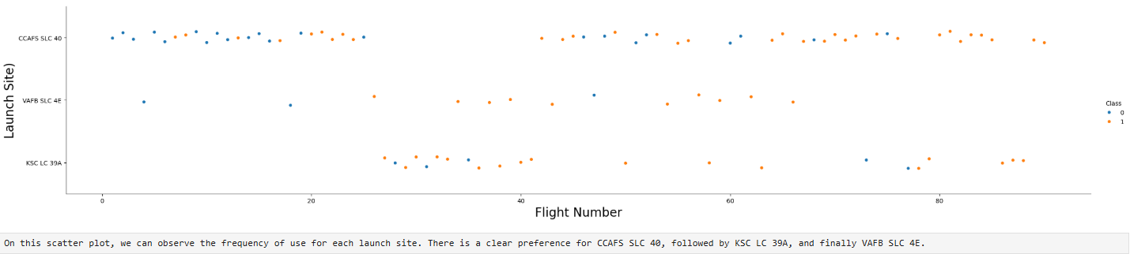
Flight Number vs. Launch Site

Slide 19
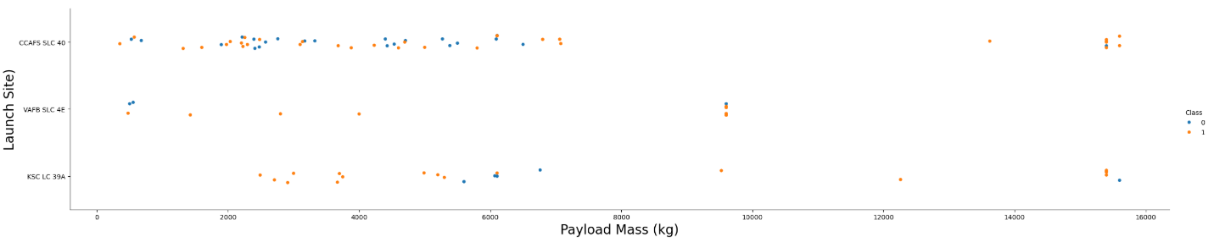
Payload vs. Launch Site
In the Payload Mass vs. Launch Site scatter plot, it is evident that no rockets have been launched from the VAFB-SLC launch site with heavy payloads (greater than 10,000 kg). Additionally, the majority of launches were conducted with lighter payloads, with only a small cluster of data points representing heavier payloads.

Slide 20
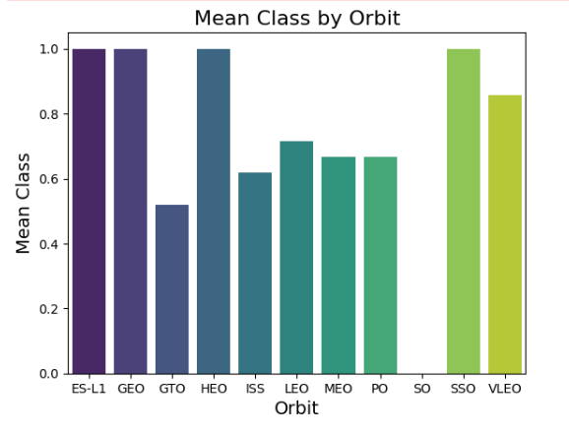
Success Rate vs. Orbit Type
Here, we can see that all launches to ES-L1, HEO, and SSO were successful. In contrast, the orbit with the lowest proportion of successful launches was GTO, with only 50% success, while SO had a 0% success rate, likely due to the absence launches to this orbit.

Slide 21
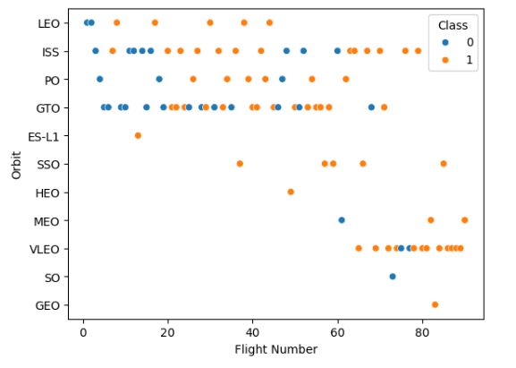
Flight Number vs. Orbit Type
You can observe that in the LEO orbit, success seems to be related to the number of flights. Conversely, in the GTO orbit, there appears to be no relationship between flight number and success.

Slide 22
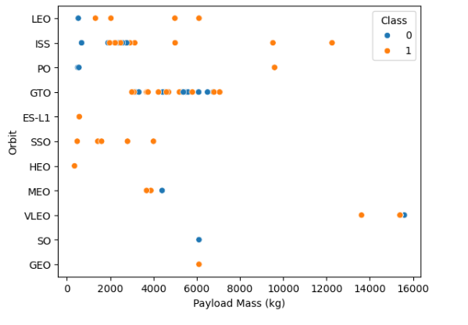
Payload vs. Orbit Type
With heavy payloads the successful landing or positive landing rate are more for Polar,LEO and ISS.
However, for GTO, it's difficult to distinguish between successful and unsuccessful landings as both outcomes are present

Slide 23
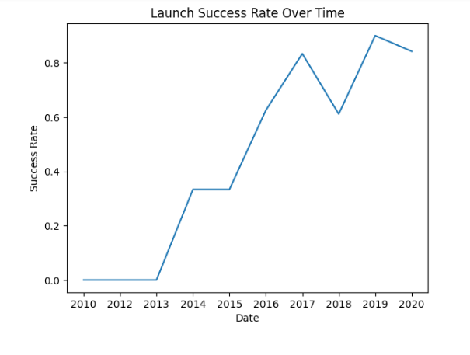
Launch Success Yearly Trend
You can observe that the success rate since 2013 kept increasing till 2020

Slide 24
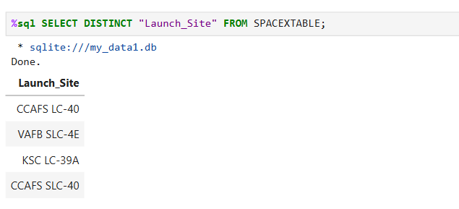
All Launch Site Names
The result of our query indicates that SpaceX utilized four launch sites for all its rockets

Slide 25
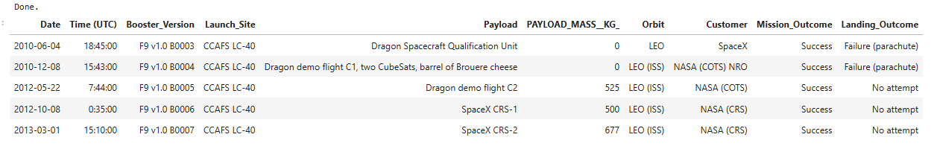
Launch Site Names Begin with 'CCA'
Here we have identified five records of launch sites whose names begin with "CCA," specifically referring to two of our four sites: CCAFS LC-40 and CCAFS SLC-40. Additionally, we can access more detailed information about each launch, including the date, booster version, and mission outcome.

Slide 26
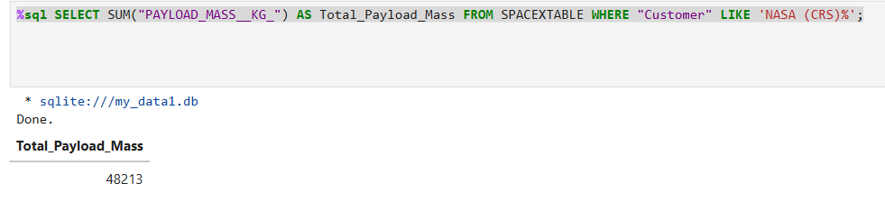
Total Payload Mass
We calculated the total payload mass carried by boosters launched by NASA (CRS) using the following query:

Slide 27
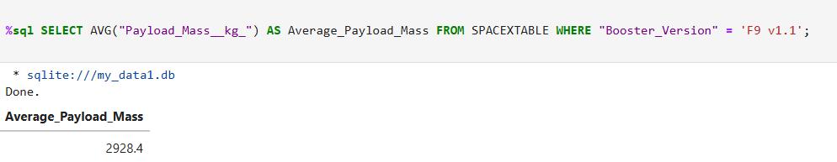
Average Payload Mass by F9 v1.1
We calculated the average payload mass carried by the F9 v1.1 booster version using the following query:

Slide 28
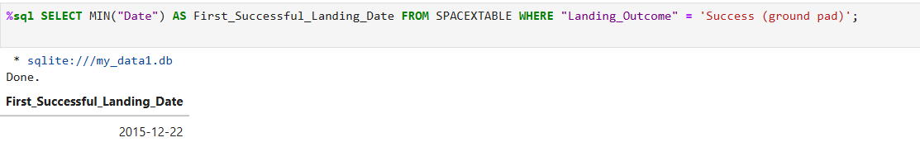
First Successful Ground Landing Date
We found the date when the first successful landing outcome in ground pad was achieved by using the following query:

Slide 29
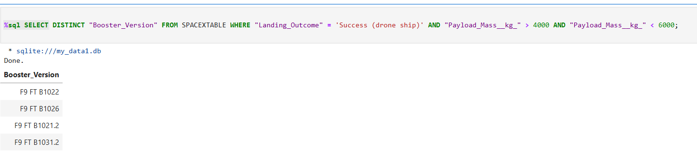
Successful Drone Ship Landing with Payload between 4000 and 6000
We found the names of the boosters which have success in drone ship and have payload mass greater than 4000 but less than 6000 by using the following query:

Slide 30
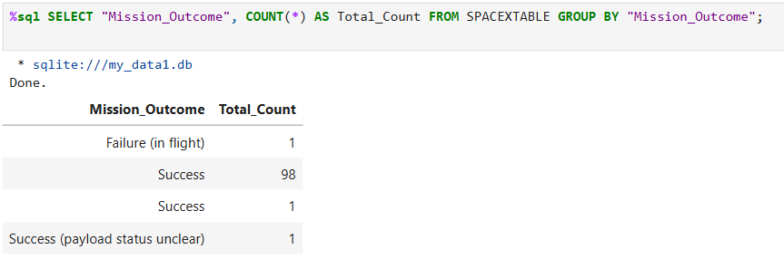
Total Number of Successful and Failure Mission Outcomes
We found the total number of successful and failure mission outcomes by using the following query:

Slide 31
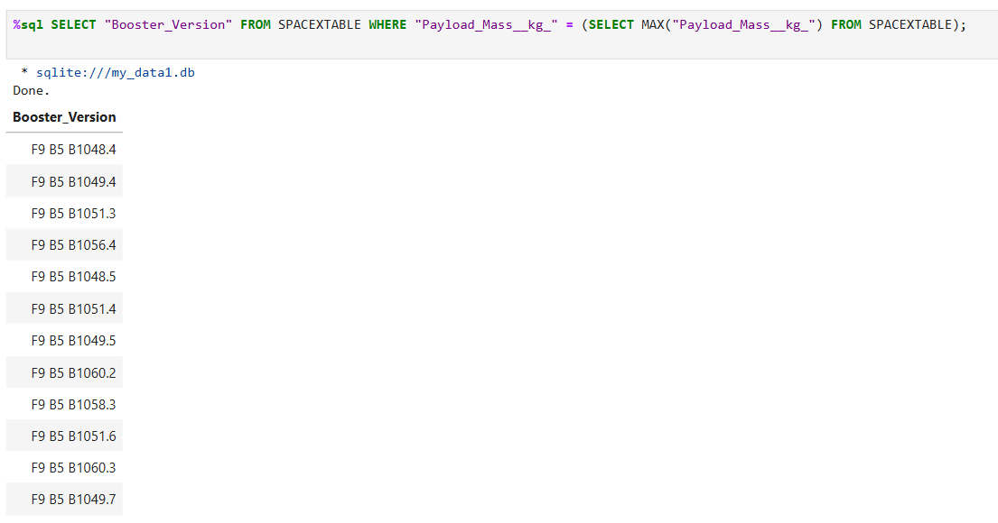
Boosters Carried Maximum Payload
Here, we used a subquery (SELECT MAX("Payload_Mass__kg_") FROM SPACEXTABLE) to list the names of the booster_versions which have carried the maximum payload mass

Slide 32
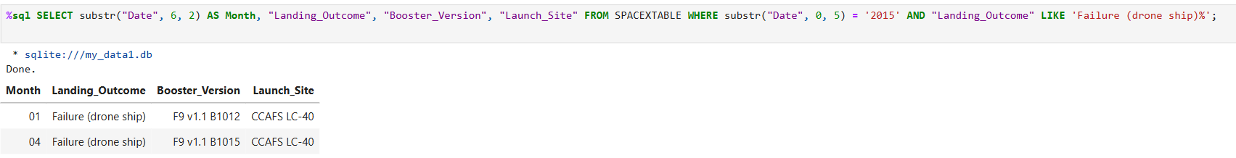
2015 Launch Records
This query extracts records from the year 2015, specifically for failure landing outcomes in drone ships, and includes the month, booster version, and launch site from those records.

Slide 33
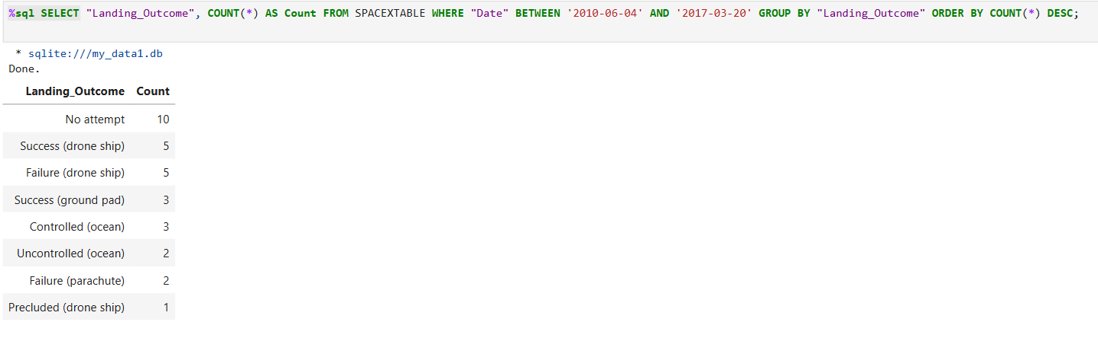
Rank Landing Outcomes Between 2010-06-04 and 2017-03-20
This query counts the number of landing outcomes between June 4, 2010, and March 20, 2017, and ranks them in descending order based on the count of each outcome.

Slide 34

Section 3

Slide 35
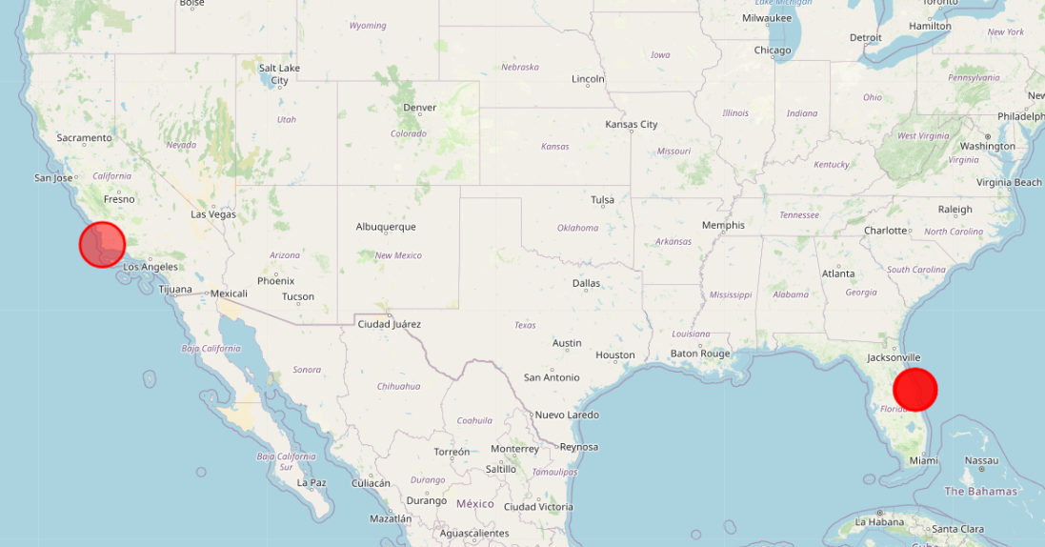
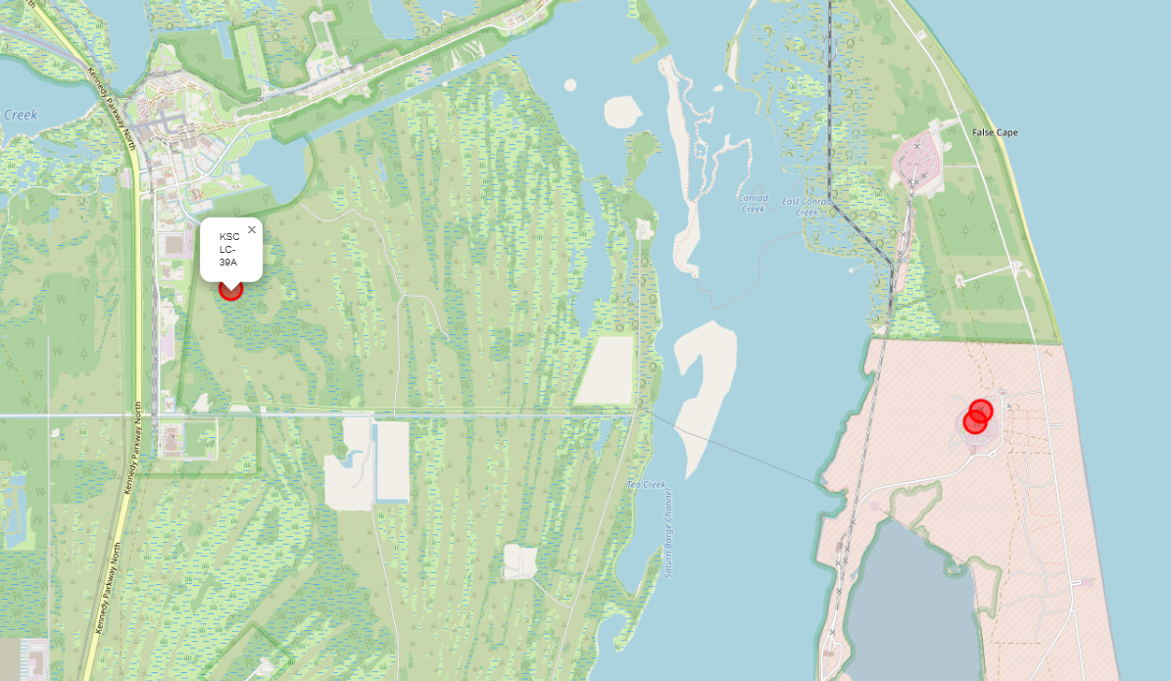
SpaceX Launch Sites
The images below illustrate the locations of SpaceX's four launch sites, each identified by a popup feature displaying their names. The overlapping circles indicate proximity, with a deeper shade of red signifying areas where the sites are closer together.

Slide 36
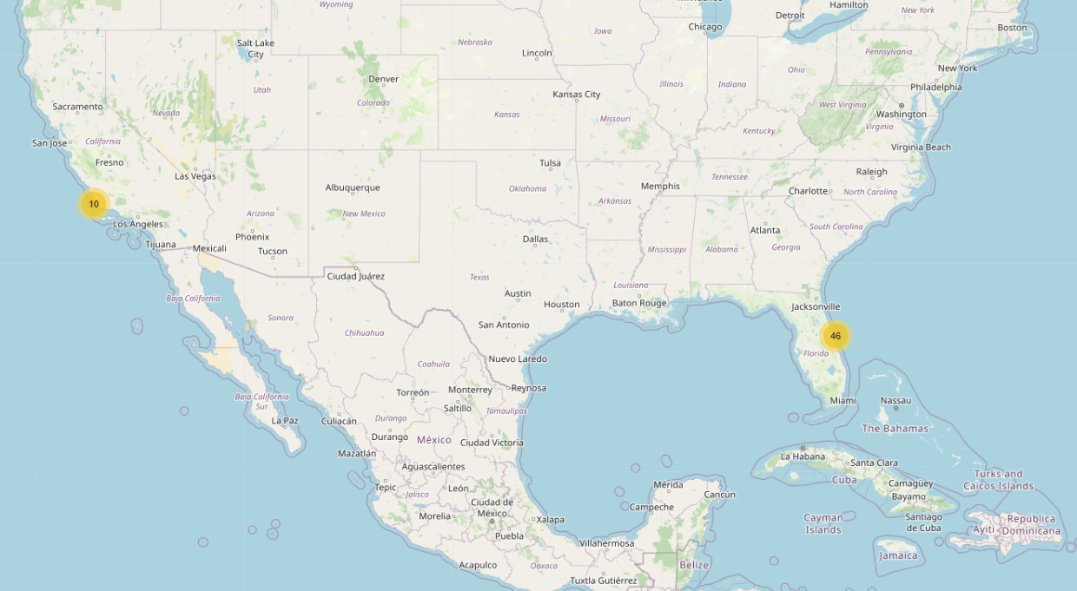
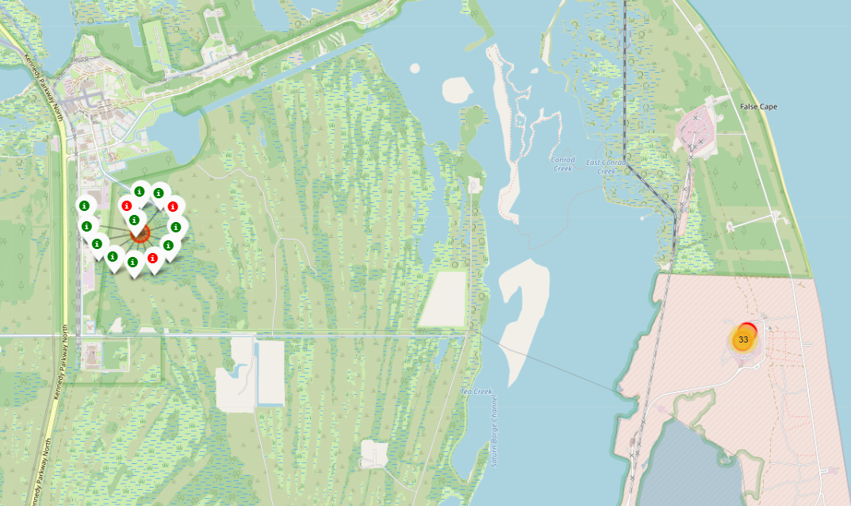
Success Rates of SpaceX Launches by Location
The images below show the number of launches at each site. The colors indicate which launches were successful (green) and which failed (red), allowing us to calculate the failure rate for each site.

Slide 37
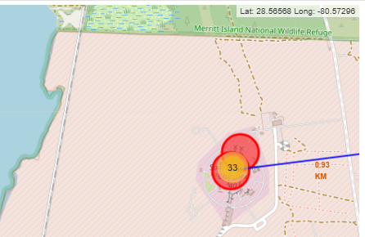
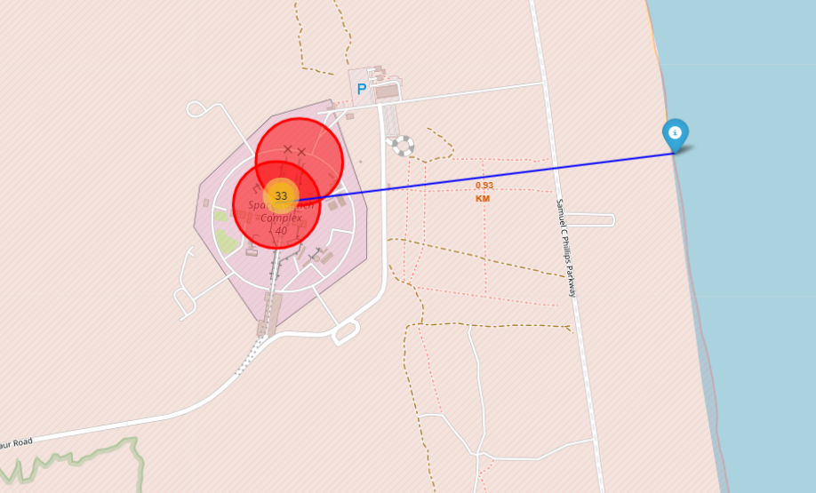
Using Folium to Explore SpaceX Launch Sites
In this section, we explore some useful tools. MousePosition allows us to find the coordinates of a specific point on the map (as seen in the top right corner of the first map). PolyLine enables us to draw a line and determine the distance between two selected points. Here, we can see the distance from one of the launching sites to the coastline.

Slide 38

Section 4

Slide 39
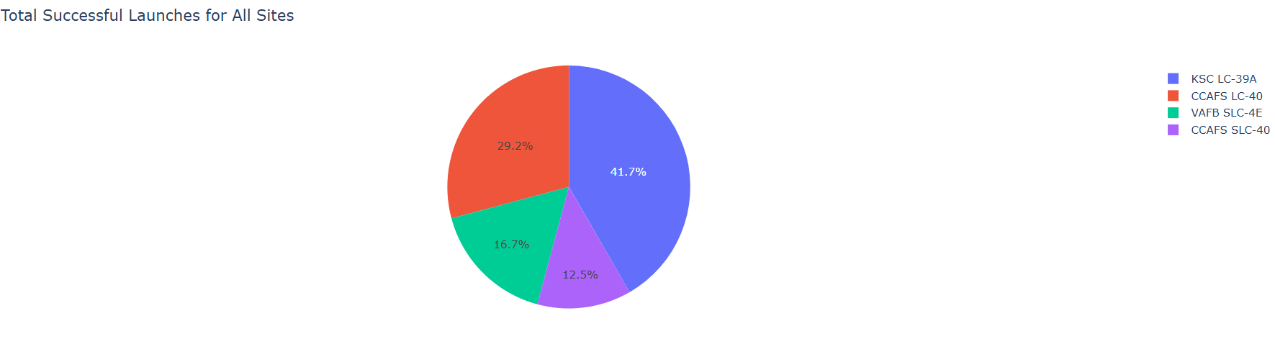
Total Successful SpaceX Launches by Site
This pie chart illustrates the distribution of successful launches across the four SpaceX launch sites. The most notable observation is that a significant number of successful launches occurred at KSC LC-39A, which recorded 10 successful launches. In contrast, the site with the fewest successful launches was CCAFS SLC-40, achieving only 3 successful launches.

Slide 40
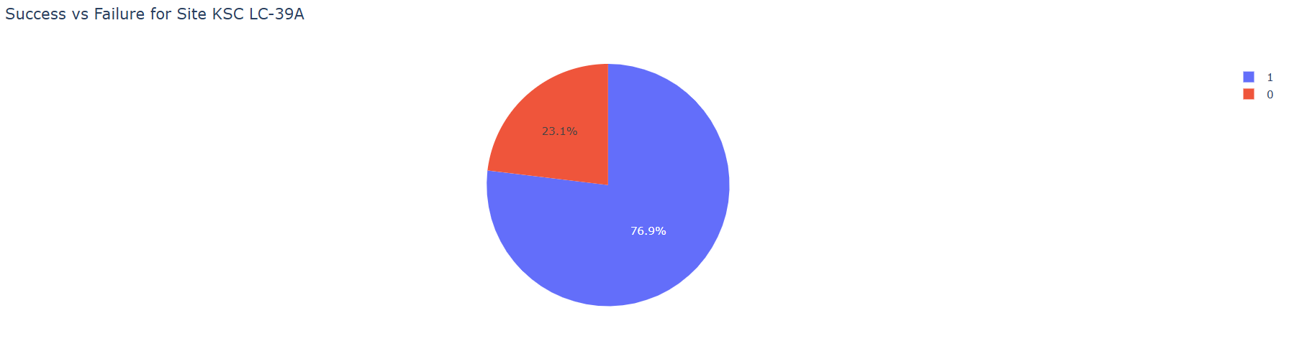
Success Rate for Site KSC LC-39A
Here, we can see closely the most successful launch site: Kennedy Space Center Launch Complex 39A (KSC LC-39A). In the previous chart, we noted that 10 of its launches were successful. Now, we can see that these 10 successful launches represent 76.9% of all launches conducted at this site, indicating that there were 3 additional launches that were not successful.

Slide 41
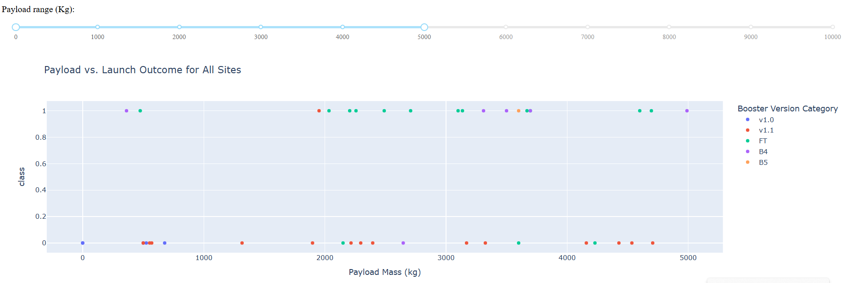
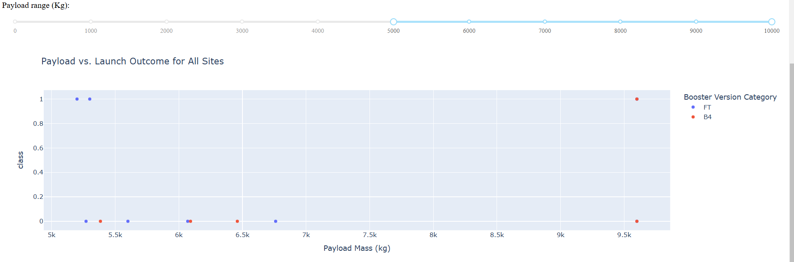
Payload vs. Launch Outcome for All Sites
Some observations we can make based on these graphs are that the vast majority of successful launches used B4 and FT boosters; however, both of these boosters failed when carrying payloads larger than 5,500 kg. The v1.1 booster was used many times for payloads below 5,000 kg but failed repeatedly. Finally, the majority of the launches carried payloads of less than 5,000 kg.

Slide 42

Section 5

Slide 43
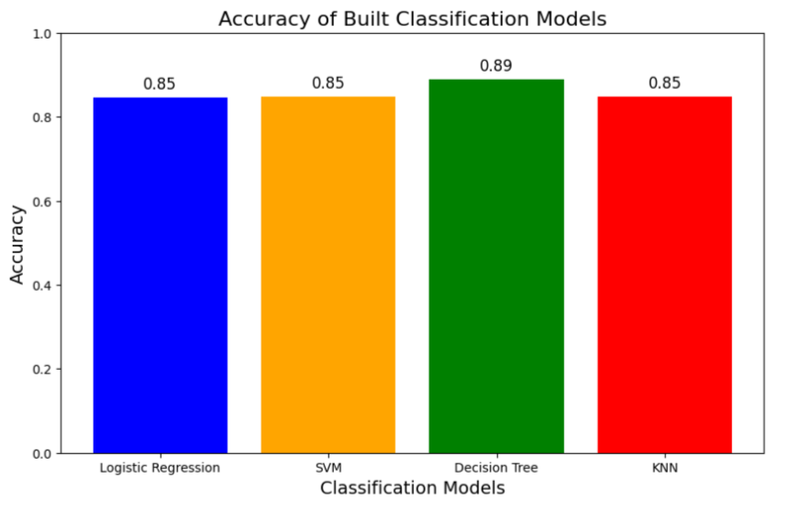
Classification Accuracy
Due to the likely insufficient test set size (a sample size of 18), every model has an accuracy of 0.8333 when predicting on the unseen test set. Therefore, we will instead compare the best scores for each model.
In this bar chart, we can see that the Decision Tree performs the best.

Slide 44
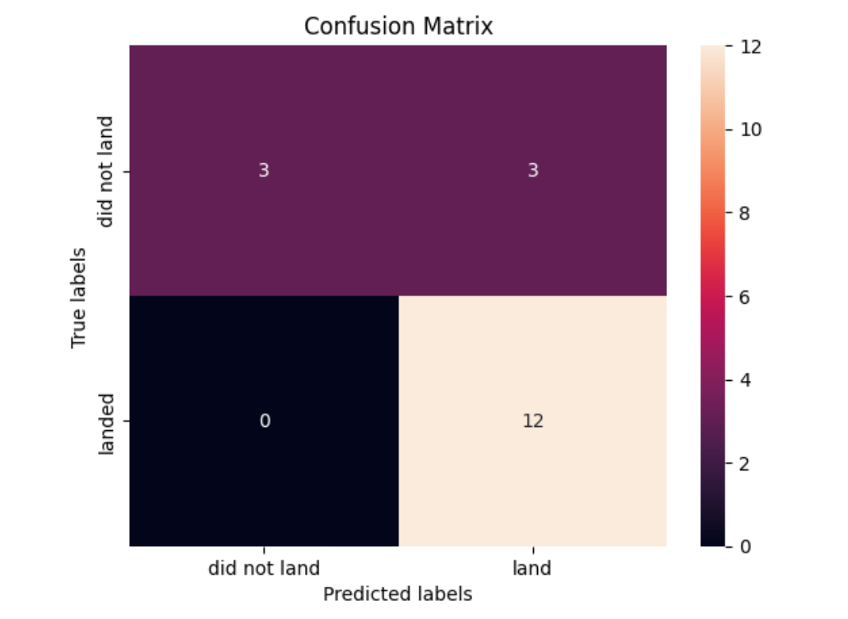
Confusion Matrix
The confusion matrix of the Decision Tree model shows 3 false positives, 12 true positives, and 3 true negatives.
This results in a total of 15 correct predictions out of 18, giving an accuracy of 0.833, which aligns with the accuracy previously discussed.

Slide 45
Conclusions
The success rates of launches were not adversely affected by heavy payloads. These heavier payloads were tested at a later stage, reaching a maximum weight of 10,000 kg, which is approximately four times the weight of an average launch.
Based on our initial premise that successful launches enable rocket reusability, we estimate that between 2013 and 2017, a maximum of eight rockets were reused. This translates to savings of around $8 billion compared to a similar company that does not reuse rockets. However, it is important to note that this estimate excludes many critical factors that would likely reduce the actual savings.
According to our predictive model, we estimate an 83% chance of saving $100 million for each rocket launch. However, we observed that when working with limited results, machine learning offers less valuable insights compared to other data visualization tools.

Slide 46
Appendix
For additional information, please refer to the resources available at https://github.com/simonzarama/coursera

Slide 47


